Slide 1

GuardDuty Eye
Secure us in our dangerous world

Slide 2
Building a Computer Vision Model to Detect Harmful Situations in school cam
AI Camera Detection System

Slide 3
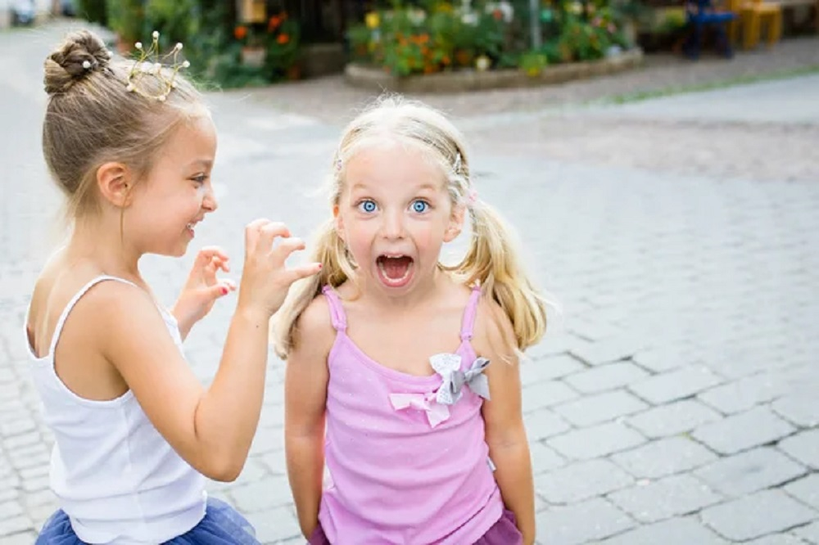
Bullying

Slide 4
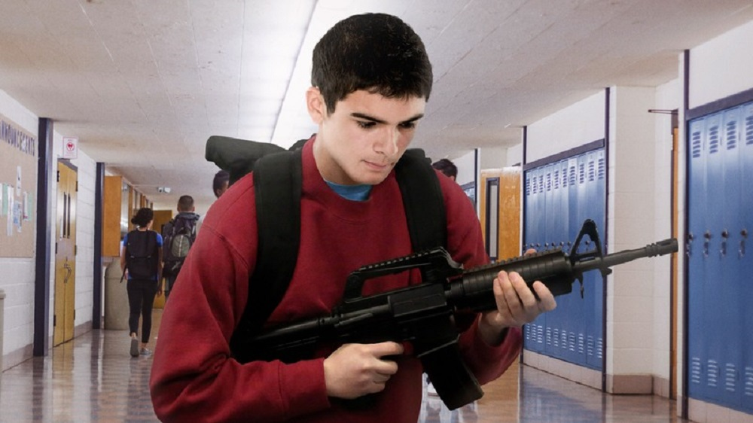
Holding-Gun

Slide 5
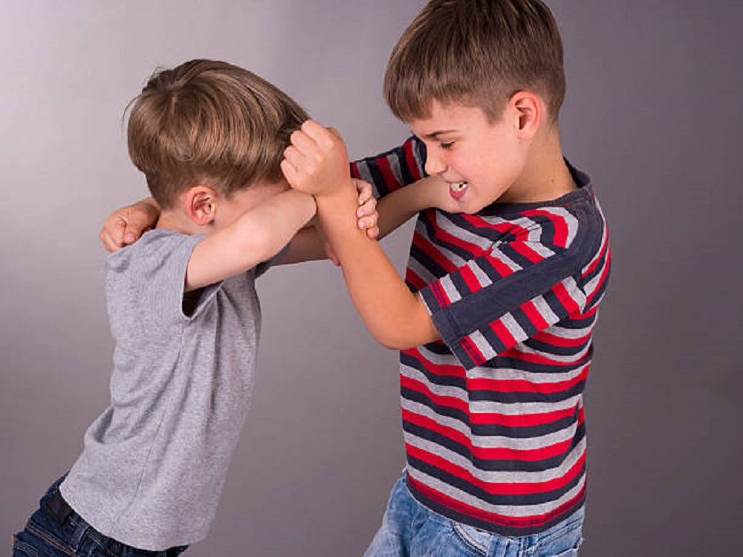
Fighting-Arm

Slide 6
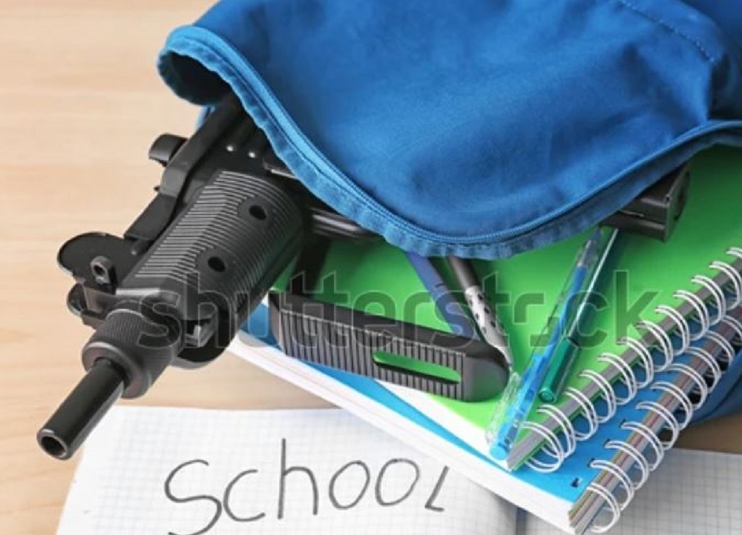
Hidden-Gun

Slide 7
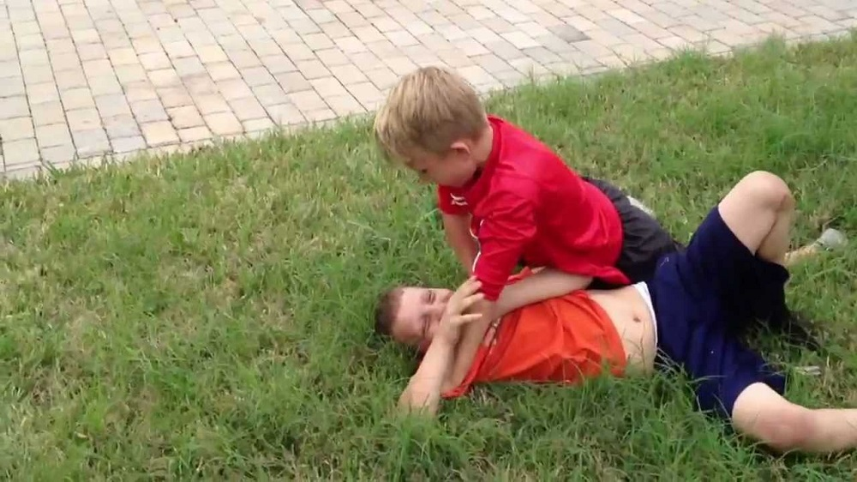
Ground-Wrestling

Slide 8

Stop Kids From Replicating Unsafe Behaviors

Slide 9

thanks
https://abdelrazekrizk.github.io/
#Microsoft Azure Responsible AI Hackathon

